Slide 1




ToxicoGx – An R platform for integrated toxicogenomics data analysis
Sisira Kadambat Nair
Benjamin haibe-Kains lab
Princess Margaret Cancer Centre
University Health Network, Toronto
sisira.nair@uhnresearch.ca
October 24, 2019

Slide 2
Scope
Introduction to Toxicogenomics
TG-GATEs datasets
ToxicoGx toolbox
Case studies using ToxicoGx
Future directions

Slide 3
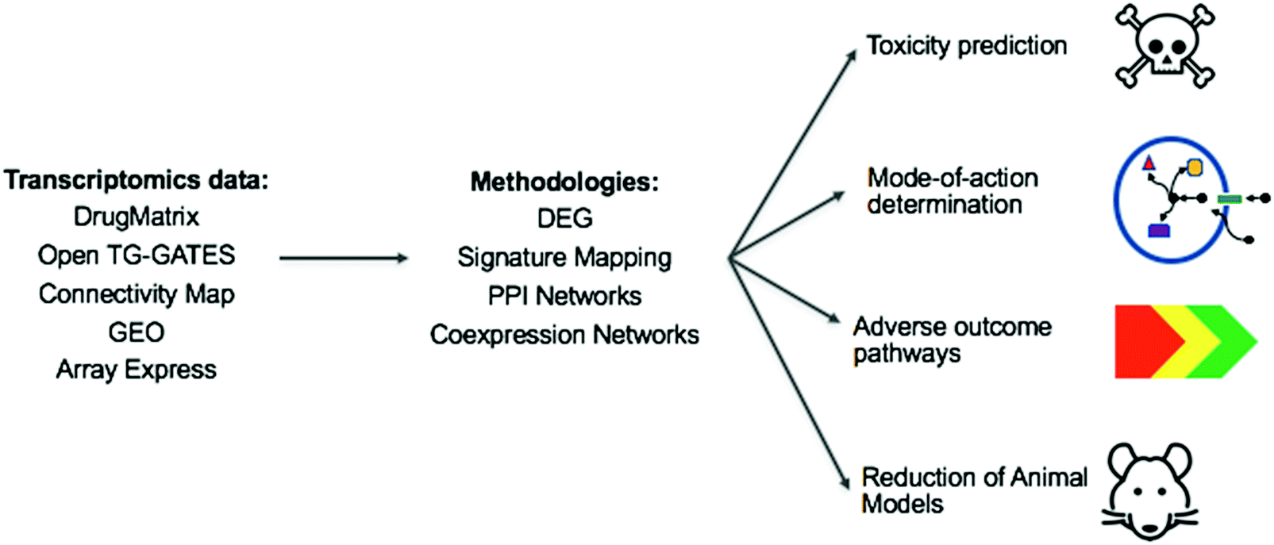
Introduction to Toxicogenomics
Toxicogenomics refers to the global analysis of modifications induced by a toxicant among any type of biomolecules (transcriptome, metabolome, proteome) to characterize pathways of toxicity (Céline Campagna et al.)
Objective – To understand and curate publicly available toxicogenomics datasets such as TG GATEs, DrugMatrix, OpenRiskNet datasets, so as to facilitate in house processing of raw data and subsequent analysis.
Andreas Bender et al
Notes:
PMID: 29917034
Bringing down drug attrition rates and reduce the use of animal models
TGX is a sub discipline of pharmacology which looks at modification in the genome such as transcriptomics/metabolomics/proteomics and so on, to specifically look at toxic response of drugs

Slide 4
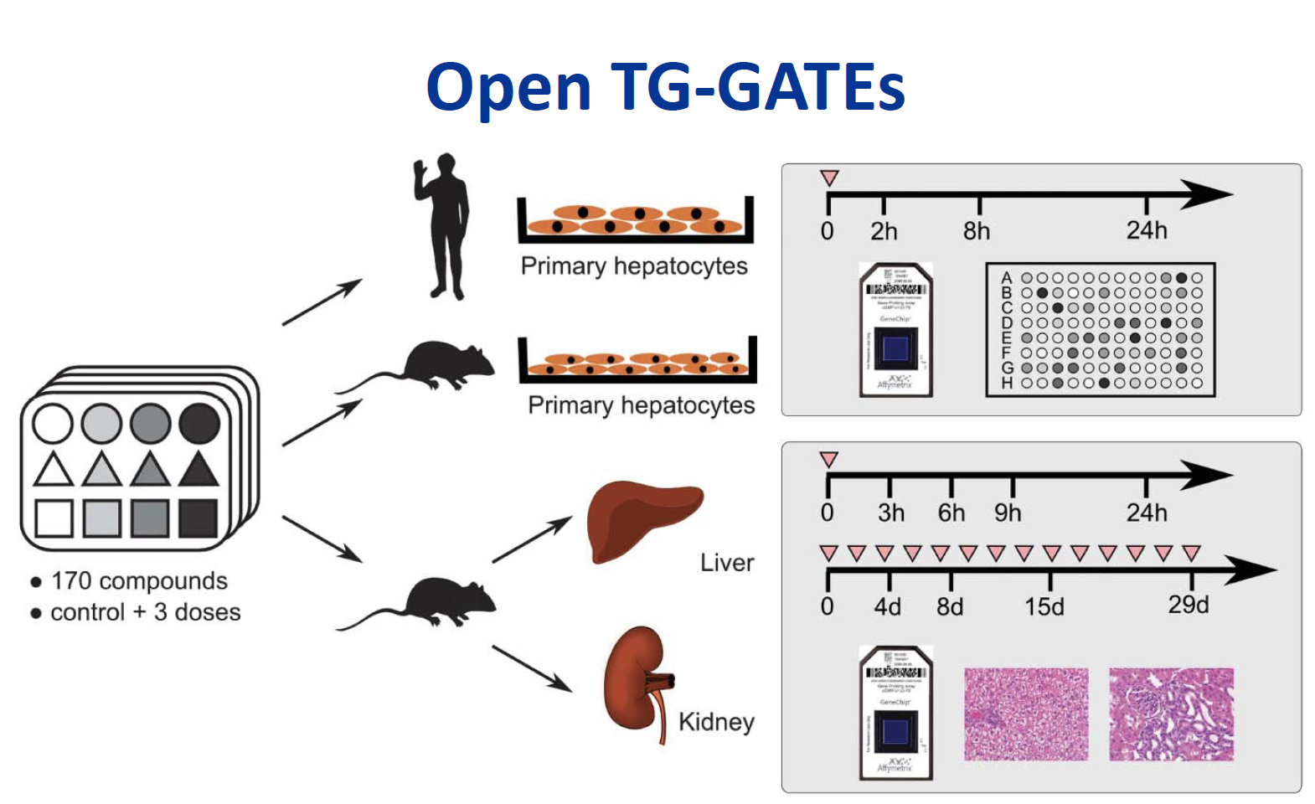
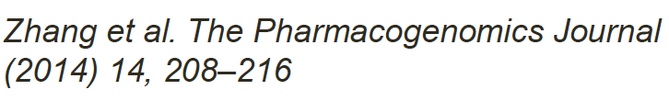
TG GATEs Datasets
Open Toxicogenomics Project - Genomics Assisted Toxicity Evaluation Systems (TG-GATEs)
A joint government-private sector project organized by the National Institute of Biomedical Innovation (Japan), National Institute of Health Sciences and 15 pharmaceutical companies.
Stage 1 – TGP (2002– 2006) : Build a database for gene expression and toxicity in rats and the primary human hepatocytes following exposure to 150 compounds.
Stage 2 – TGP2 (2007– 2011) : discovered over 30 different safety biomarkers using TG-GATEs

Slide 5
TG GATEs Datasets
Dataset | Cell type | Study Type | No. of drugs | Dose level | Sample collection after treatment | Biological replicates | Microarray platform | Parameters assayed
TG-GATEs | Primary human hepatocytes | In vitro | 146 | Control, low, medium, high | 2,8,24hr | Duplicate | Affymetrix human U133 Plus | Gene expression & Cell viability(LDH,DNA)
TG-GATEs | Primary rat hepatocytes | In vitro | 140 | Control, low, medium, high | 2,8,24hr | Duplicate | Rat Genome 230 2.0 | Gene expression & Cell viability(LDH,DNA)

Slide 6
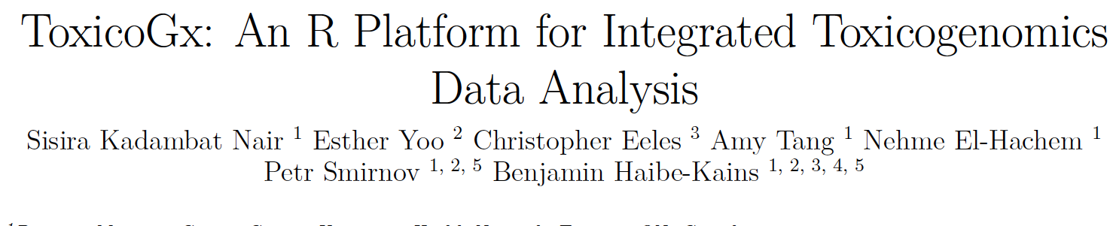
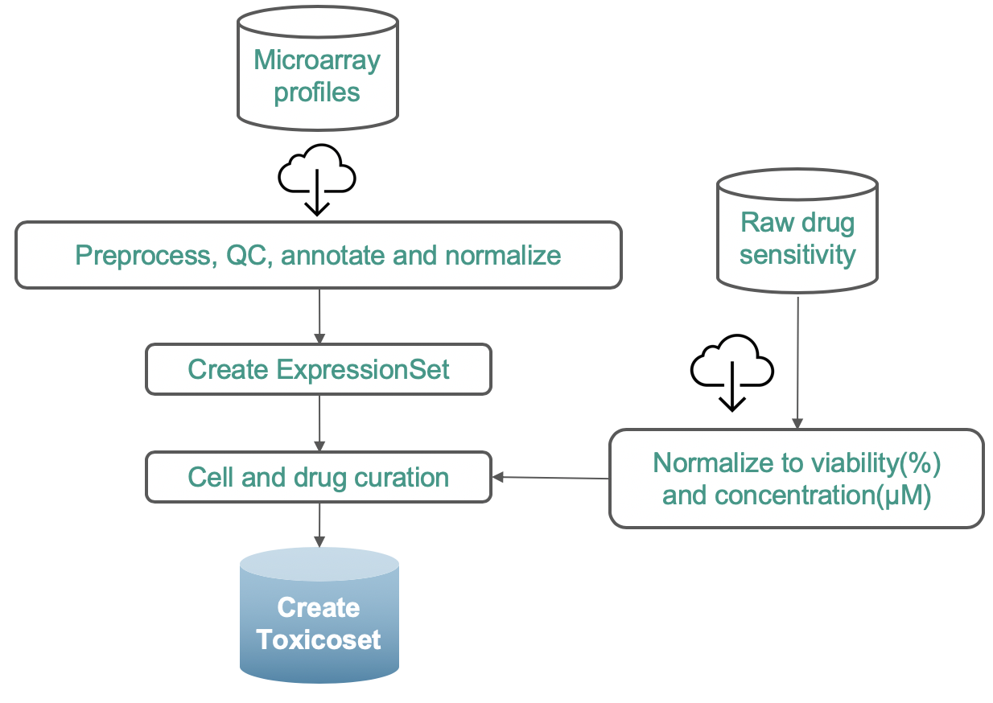
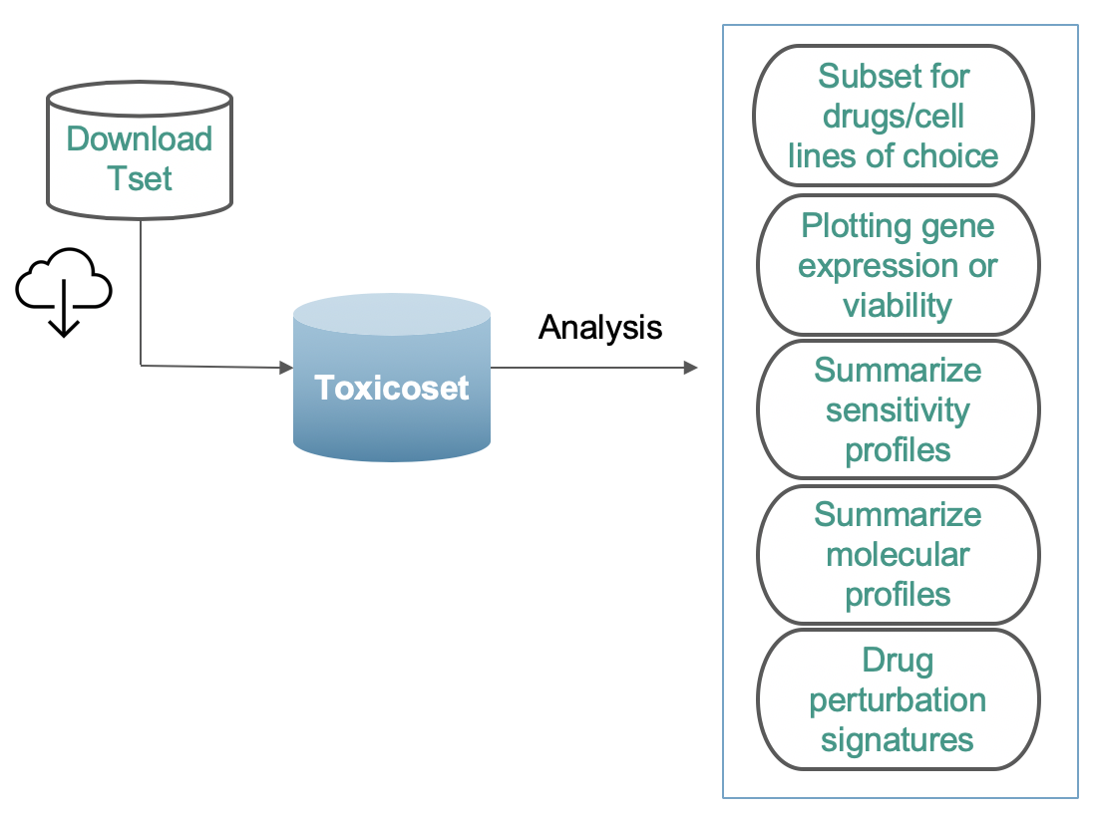
The ToxicoGx Toolbox
R package [first release]

Slide 7
ToxicoGx – Dataset Structure
Cell (SampleInfo)
Drugs
Molecular Profiles (rna)
TSet
Sensitivity
Info (metadata)
Profiles(Slope,AAC)
Raw(dose & viabilility)
Curation
Cell & drug

Slide 8
Case studies - ToxicoGx
How to plot gene expression versus time.
Reproducing connectivity map analysis from published data
Pan GSEA of TG-GATEs human in vitro Toxicoset.

Slide 9
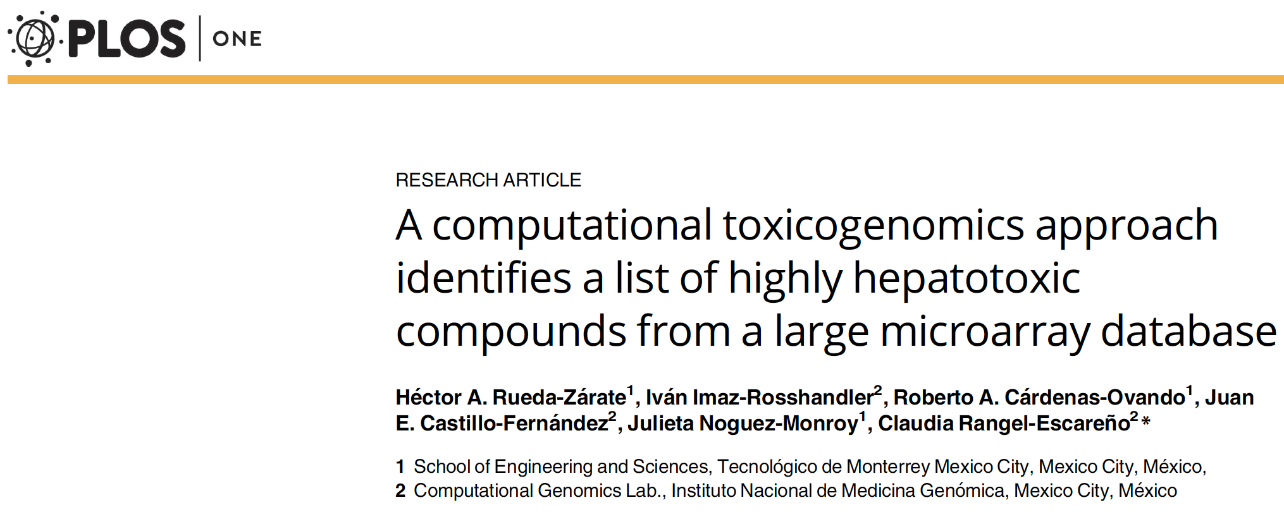
Case Study I - Plotting gene expression versus time
Gene expression changes of CYP1A1 (gene associated with xenobiotic metabolism) has been plotted at all concentrations and
time points.
Observation - Clear differential expression at time 8(hr) suggesting that higher the dose, larger the impact of CCL4 on this gene.

Slide 10
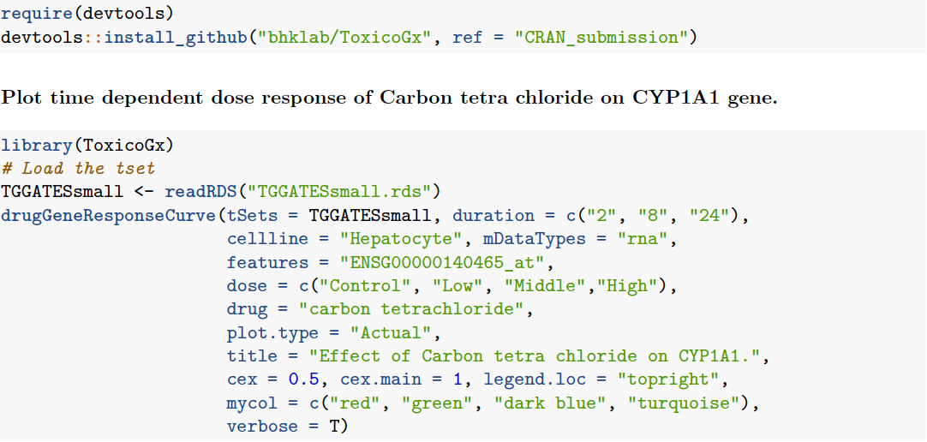
Case Study I
Install the package and load to environment
Load the datasets after downloading them using the downloadTSet function.
drugGeneResponseCurve has been used wherein mandatory inputs such as dataset, drug name, cell-line, molecular type, gene name, dose and time points should be specified.

Slide 11
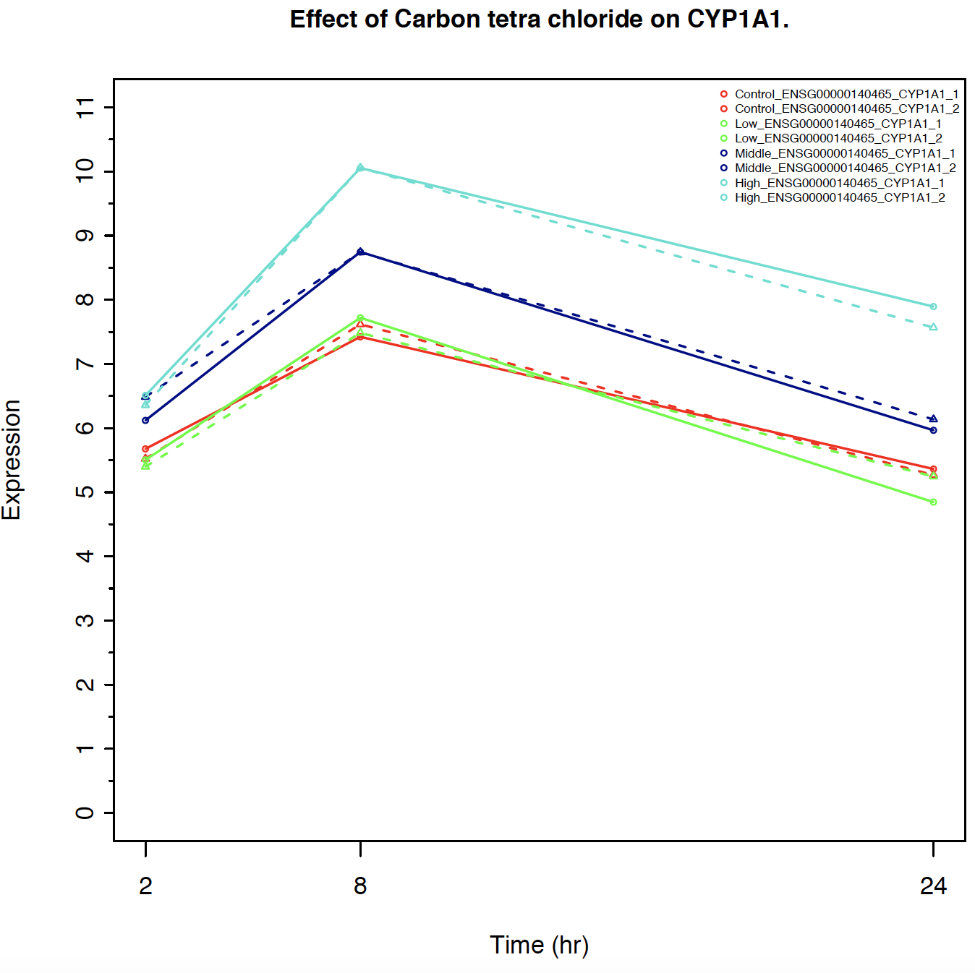
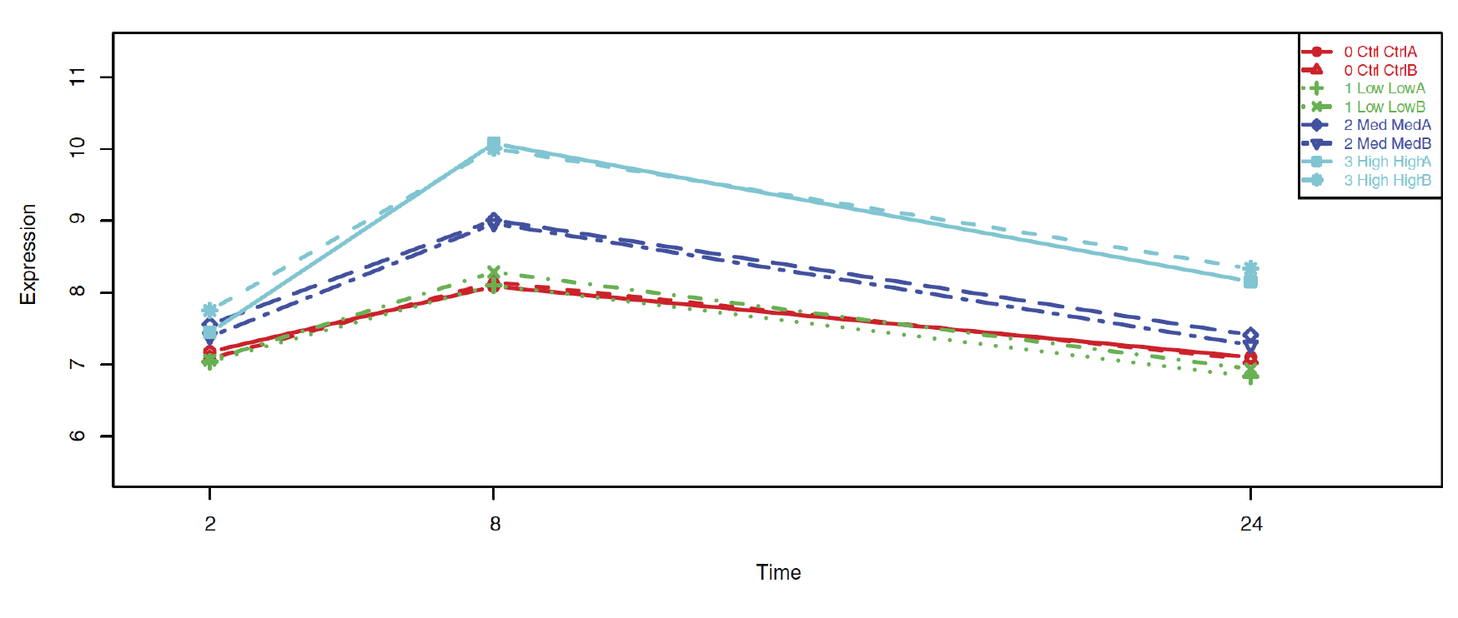
Case Study I - Effect of Carbon tetrachloride on CYP1A1
ToxicoGx
Published

Slide 12
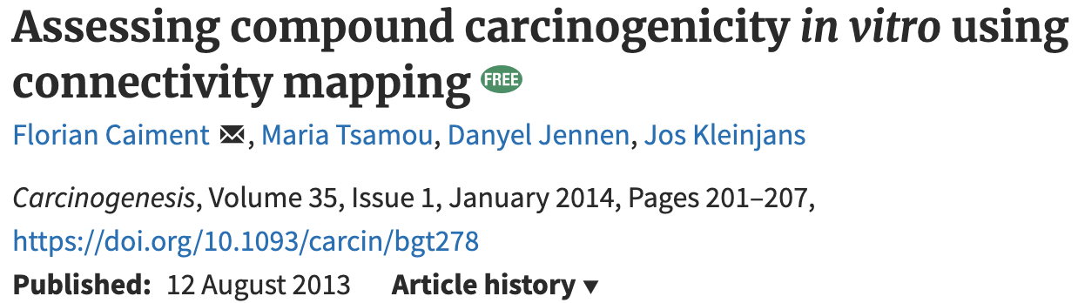
Case Study II - Connectivity map analysis - TG-GATEs & HCC
Connectivity mapping approach in predicting compound carcinogenicity by linking in vivo human hepatocarcinoma (HCC) signature with in vitro TG-GATEs primary human hepatocyte data.

Slide 13
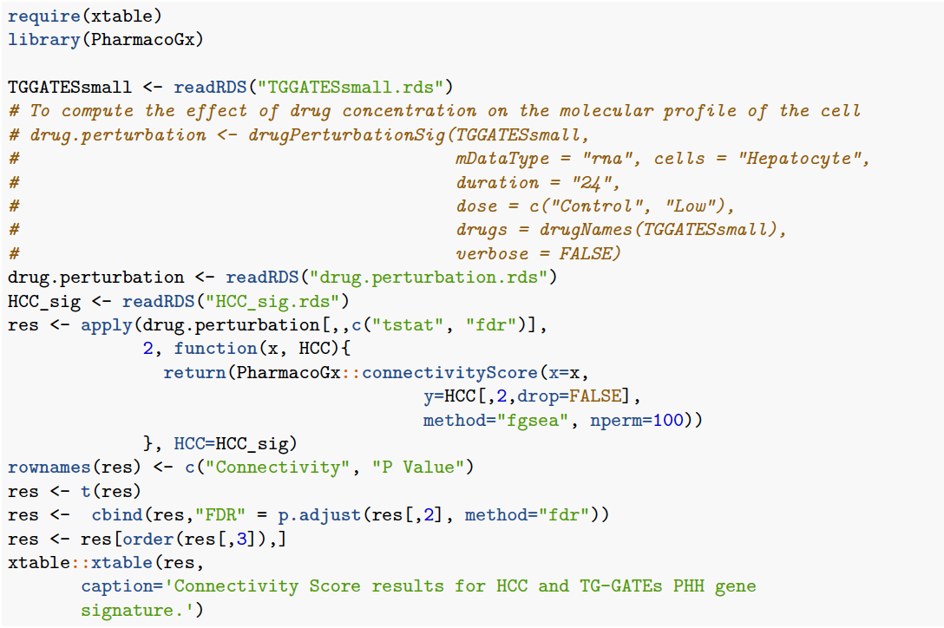
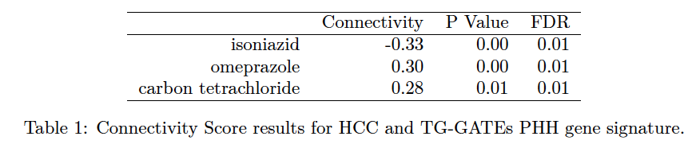
Case Study II
The HCC signature, already mapped to the gene level, has been included in this package and it can be loaded by calling data(HCC_sig).
drugPerturbationSig performs statistical modelling of transcriptomic response to the application of each drug.

Slide 14
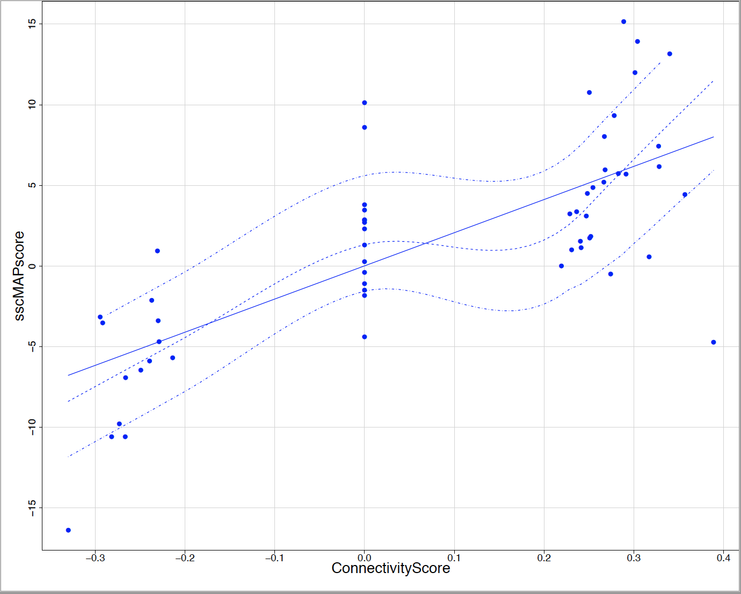
Case study II continued
Correlation between published and recomputed connectivity scores
r = 0.72

Slide 15
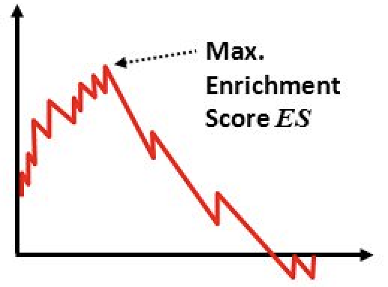
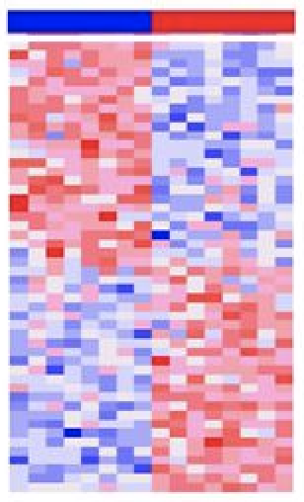


ToxicoGx – GSEA analysis
Conditions
Gene Set
Enrichment score
Ranked genes
Hit (in gene set)
Miss (not in gene set)
Ranked gene list
Pan TG-GATEs analysis to analyze enriched pathways (Reactome)
Gene signatures of all drugs at 3 concentrations and time points were used for GSEA analysis.
Significant pathways (FDR < 0.05) were selected

Slide 16
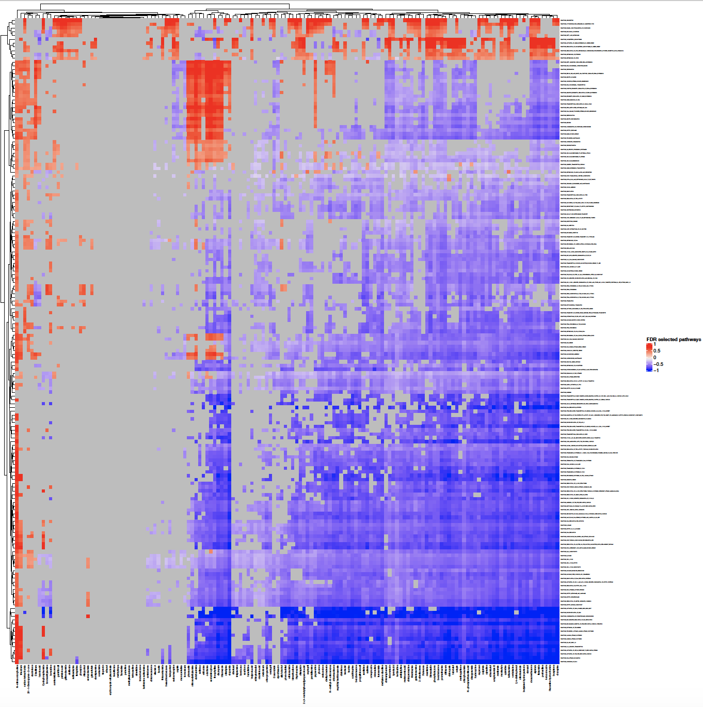
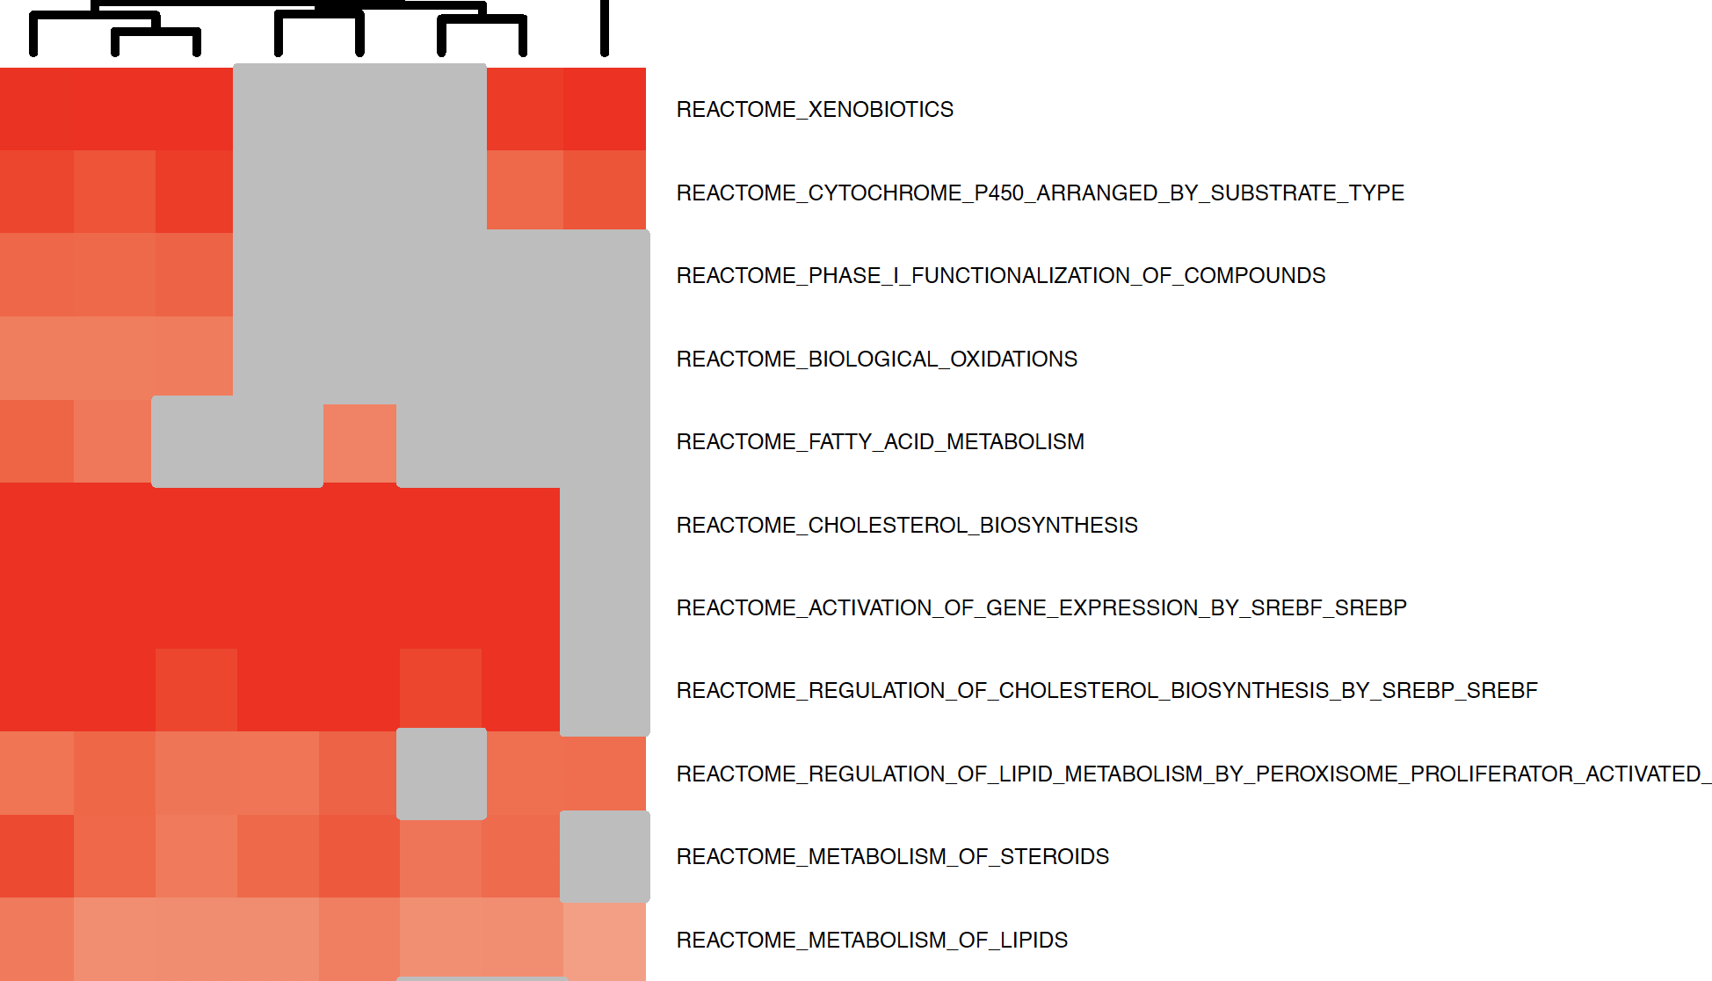
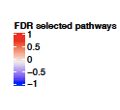
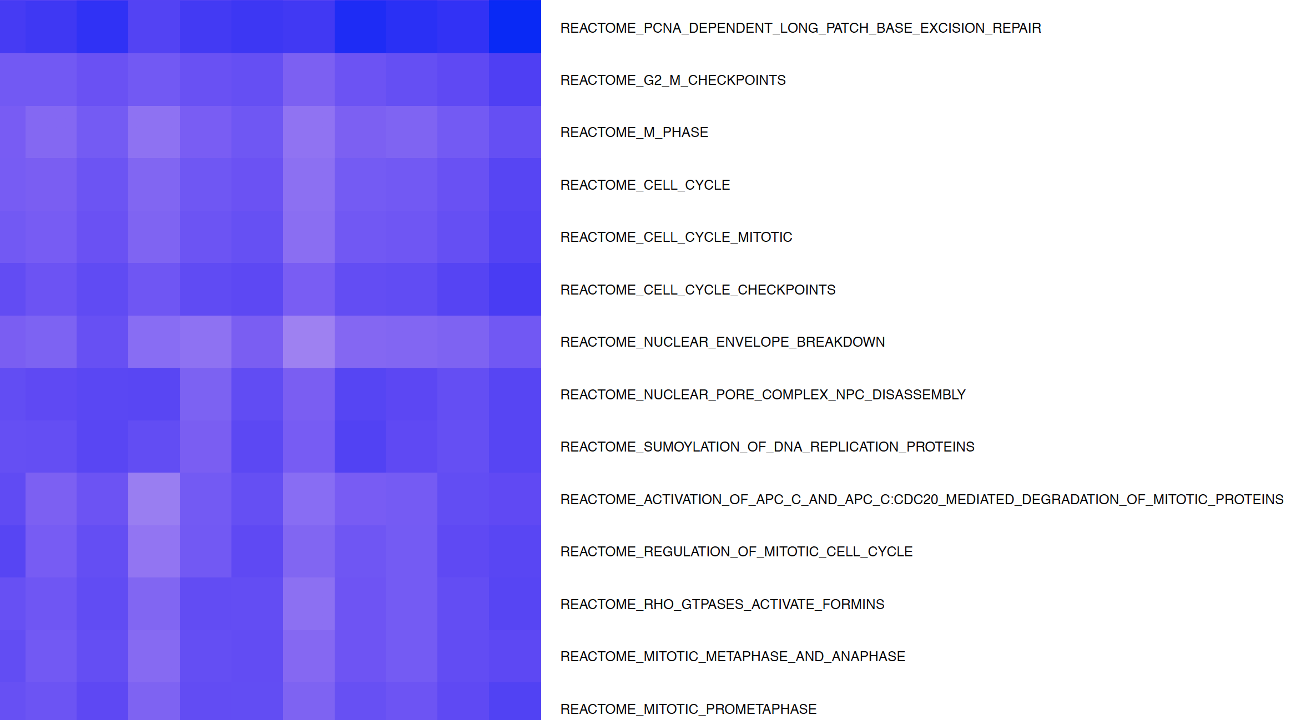
ToxicoGx – GSEA analysis
Up-Regulated
Pathways
Down-Regulated
Drugs

Slide 17
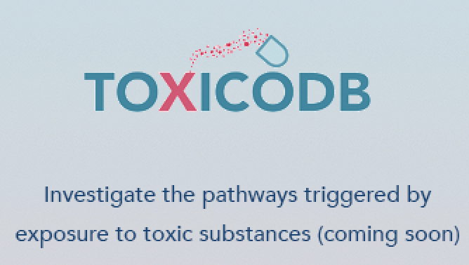
Future directions
Incorporate DrugMatrix and OpenRiskNet datasets.
Develop a web interface (ToxicoDb) that can be easily navigated by researchers as well as non-academicians.

Slide 18









Acknowledgements
Benjamin haibe-Kains
Esther Yoo
Christopher Eeles
Petr Smirnov
Wail Ba-Alawi
Nehme-El-Hachem
Amy Tang
Jie Tang

Slide 19
Thank you

